Slide 1
Project outline & vision
Dionisis Kehagias
Information Technologies Institute /
Centre for Research and Technology Hellas (CERTH/ITI)
1st MOVESMART Workshop, 15 October 2015, Bilbao

Slide 2











The Consortium
Beneficiary Number | Beneficiary name | Short name | Country
1 | Ayuntamiento de Vitoria-Gasteiz | AVG | Spain
2 | Business Innovation Brokers S. Coop., Spain | BiB | Spain
3 | Centre for Research and Technology Hellas / Information Technologies Institute | CERTH | Greece
4 | Computer Technology Institute & Press “Diophantus” | CTI | Greece
5 | Karlsruher Institut Fuer Technologie, Institute of Theoretical Informatics | KIT | Germany
6 | Universidad de la Iglesia De Deusto, Energy Unit | UD | Spain
7 | South West College | SWC | UK
8 | Grad Pula – Pola | PULA | Croatia
9 | Going Green SL, Spain | GG | Spain
10 | MLS Multimedia SA | MLS | Greece
11 | Flexiant Limited | FLEX | UK
(Coordinator)

Slide 3
The Vision of MOVESMART
Real time traffic prediction
Public transport integration
Crowd sourcing
Time-dependent route planning in large-scale urban-traffic networks
Electromobility
Car sharing/ pooling
Energy efficiency
Eco-friendliness

Slide 4
Main Project Objectives
Enable
Optimised energy efficient personal mobility services for commuters and travellers in urban environments
Develop
Crowd sourcing techniques for collecting real time user feedback for more efficient traffic prediction
Innovative energy-efficient time-dependent renewable routing paradigms
Deploy
The proposed personal mobility concept in real operating environments in 2 cities
Define
A set of appropriate Business Models on top of the newly enabled mobility services

Slide 5
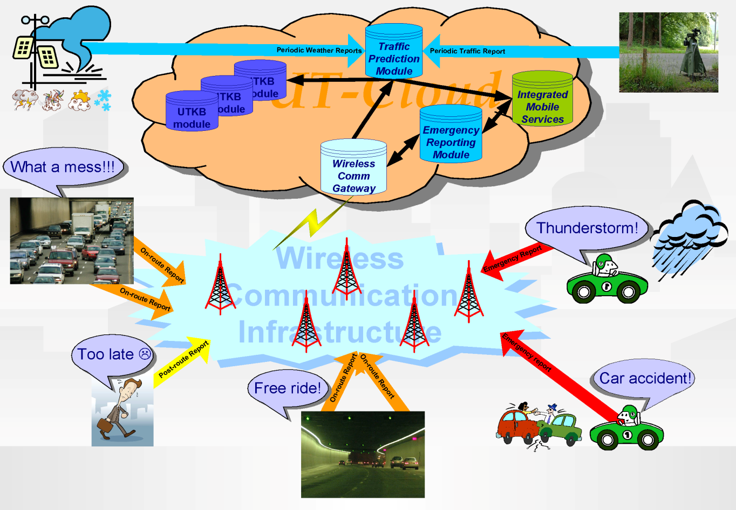
MOVESMART Concept
The Urban Traffic Knowledge Base (UTKB) maintains appropriate traffic information
Periodic traffic-sensing data will be assessed and exploited via the Traffic Prediction module
Crowd-sourcing of Traffic Information for supporting online emergency reports
The Urban-traffic cloud (UT-Cloud) architecture integrates the involved technologies

Slide 6
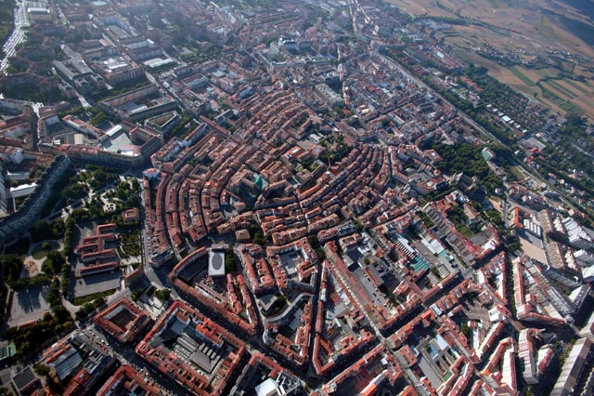
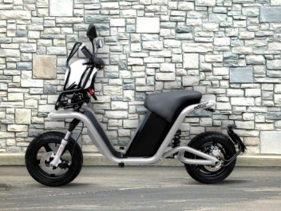
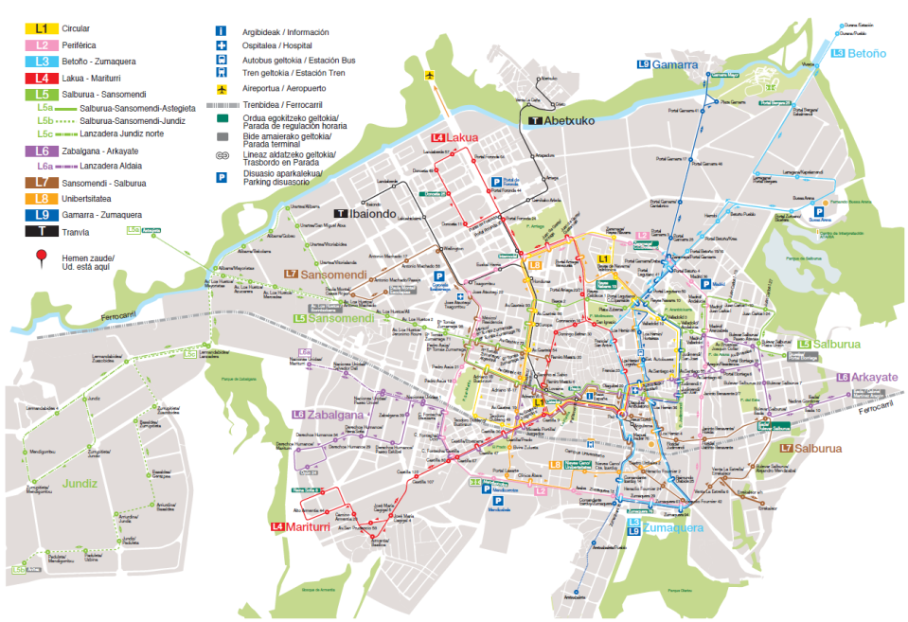
Pilot 1: Municipality of Vitoria-Gasteiz
Site Characteristics
Population: 235,000 people
Area: 280 Km2
Density: 860 inhabitants per Km2
Bus Public Transportation network
EV charging points
Scope & Purpose
Test the proposed solutions in a large sized urban environment
Deploy a MoD system, to cover sustainable mobility in the city’s urban area
Electric motorbikes
To reverse the upward trend in the use of the private car
Deal with the “first mile-last mile” problem
Test the envisaged solutions and evaluate them with respect to their environmental impact and energy gains
Notes:
6

Slide 7

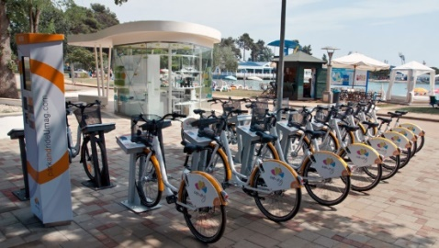
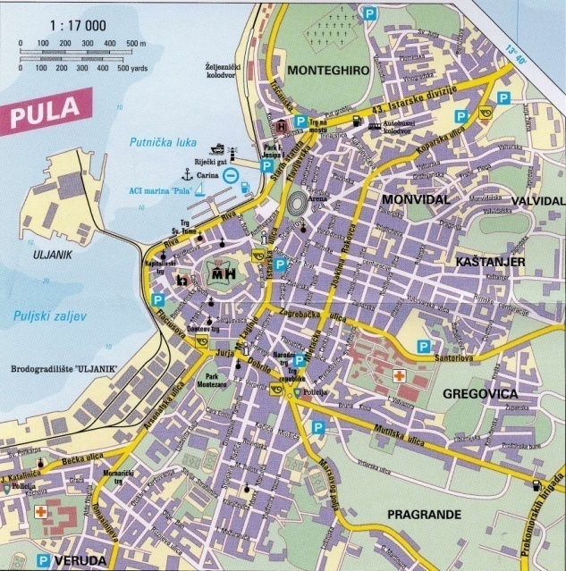
Pilot 2: Municipality of Pula-Pola
Site Characteristics
Population: 90,000 people
Area: 51.6 Km2
Density: 1,093.27 inhabitants per Km2
Bus Public Transportation network
Part of EuroVelo 9, one of the Largest European bicycle networks
Walkable city
Scope & Purpose
Test the proposed solutions in a small sized urban environment
Improve sustainable mobility modes by deploying a fleet of electric bikes
Bike sharing systems based on RFID cards
Improve transportation resources offering sustainable, rational and technologically advanced alternatives
Increase touristic interest in the city
Notes:
7

Slide 8
Key Technologies
Renewable Multimodal Mobility
Incentivized Vehicle Sharing
Crowd sourcing techniques for Real Time Traffic reporting and prediction
User information Reliability Assessment Mechanisms
Cloud Computing
Mobile Computing

Slide 9
MOVESMART Innovations
Crowd-sourcing technologies for ITS: For collecting and exploiting real-time reports of transportation experience from the users themselves, preserving data privacy and anonymity. User feedback is taken into account for assessing the crowd-sourced information
Vehicular traffic prediction techniques under atypical conditions: Integration of real-time crowd sourcing information, e.g. occurrence of traffic accidents, rapid traffic changes, weather phenomena, etc.
Computationally efficient route planning: Lightweight implementation of high-precision time-dependent multimodal route planning within the processing limitations of handheld devices and real time constraints

Slide 10
MOVESMART Innovations
Renewable Multimodal Mobility: Develop route planning algorithms particularly tailored for Electric Vehicles for providing the uninterruptible operation of the whole flee
Cloud Computing: Cloud platform for supporting the vast storage, processing and real time communication requirements of high-performance and energy-efficient ITS
Business models: New business models to reduce personal mobility costs
Mobile Crowd-sourcing on demand
Incentivised Vehicle Sharing
Integrated Energy-Efficient Personal Mobility

Slide 11
Project Achievements up to now
Innovative reliability assessment framework for crowd sourcing data
Innovative traffic prediction techniques based on crowd sourcing data
Integrate detection of abnormal traffic events for more accurate traffic prediction as opposed to the traditional approaches
Crowd sourcing data management back-end on the cloud supporting security
Live Traffic Reporter client application for Android and iOS
Innovative multimodal route planning algorithms that encompasses EV-mobility
Energy efficiency estimation models for EV
New algorithmic approaches for supporting incentives for vehicle-sharing services
Innovative mobility-on-demand business models

Slide 12






Crowd sourcing data
On-route data (collected on users’ consent as they are moving):
user location
user speed
Post-route data:
Relevance Feedback
Emergency data:
Weather info (e.g. sudden change of weather conditions)
Incidents (e.g., accidents, demonstrations, etc.)
Public Transport info (e.g. bus delays)
Traffic info (e.g. report of high congestion).

Slide 13
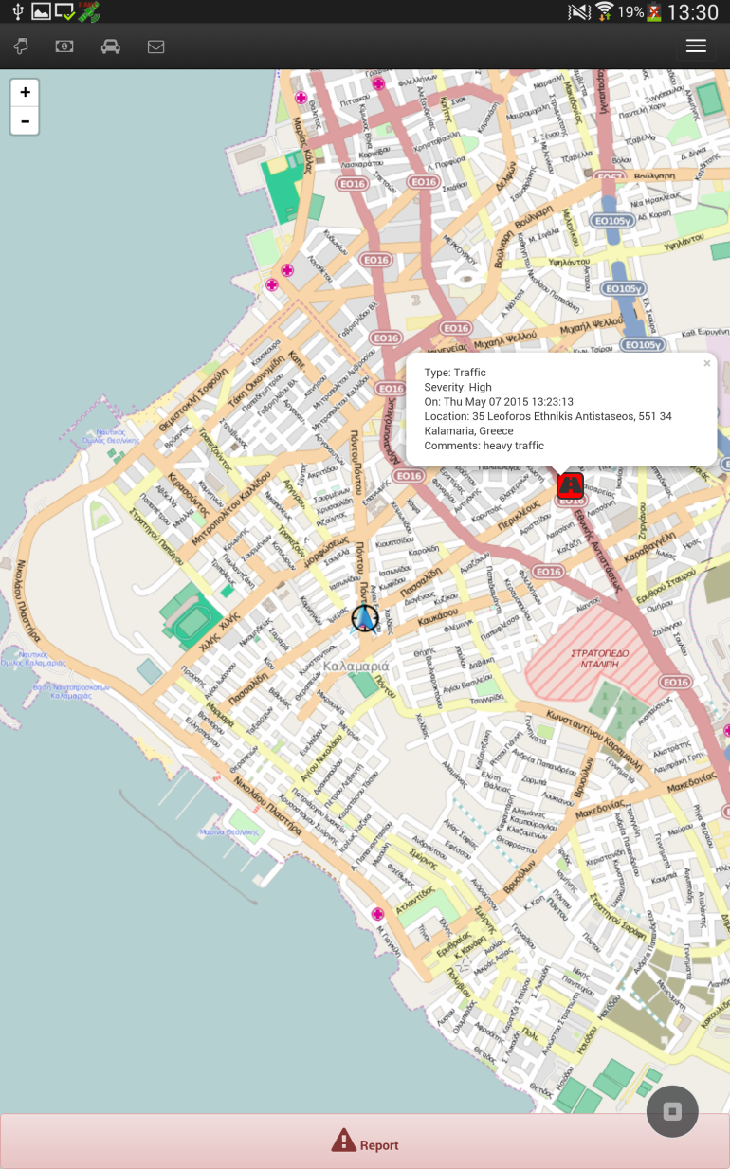
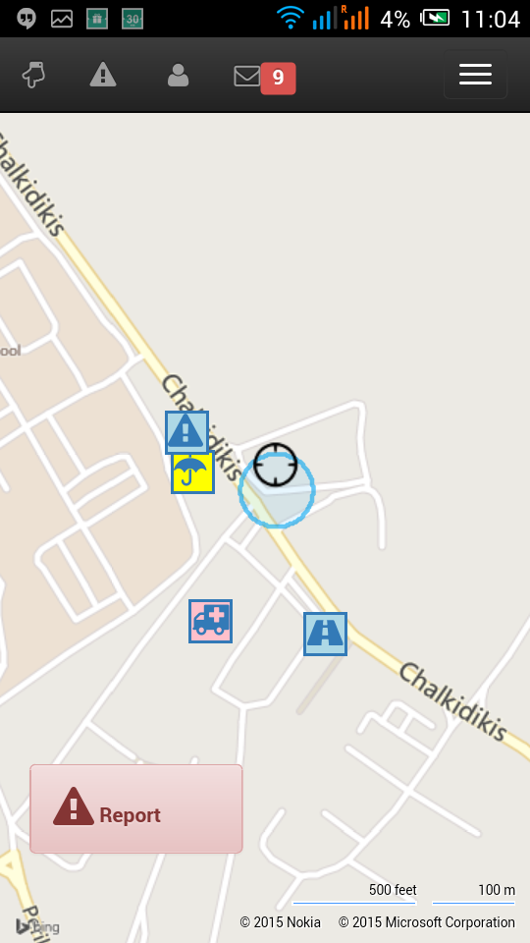
Live Traffic Reporter
Available at : http://www.movesmartfp7.eu
Allows users to send reports about real time incidents
Four types of incidents are supported: traffic congestion, weather, works and accidents
In order to ensure the reliability of the reported incidents, users are asked to validate the report in question
An advanced estimation model calculates the reliability of the report based on the speed and location of the reporting user, among other features

Slide 14
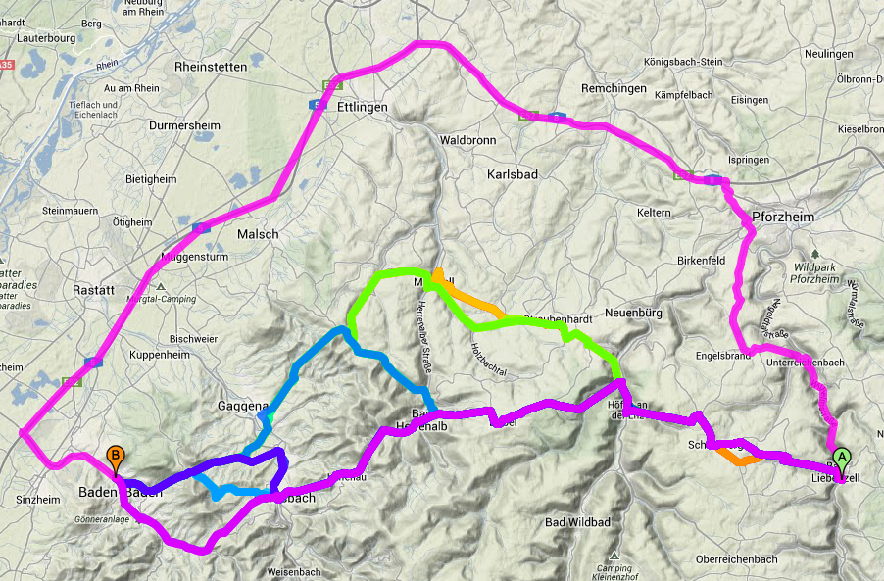
Renewable Mobility Algorithmic Approaches
Highlight – 1
Speed-Consumption Tradeoff for Electric Vehicle Route Planning
Electric Vehicles (EVs):
Future means of transportation
Run on regenerative energy sources
Downsides of EVs:
Restricted battery capacity
Long recharging times
“Range anxiety”
Consider energy consumption in route planning applications
Results:
Trade travel time and energy consumption via Pareto optimization
Driving road segments at different speed
Accelerated query times hours to <1s (very little error)

Slide 15
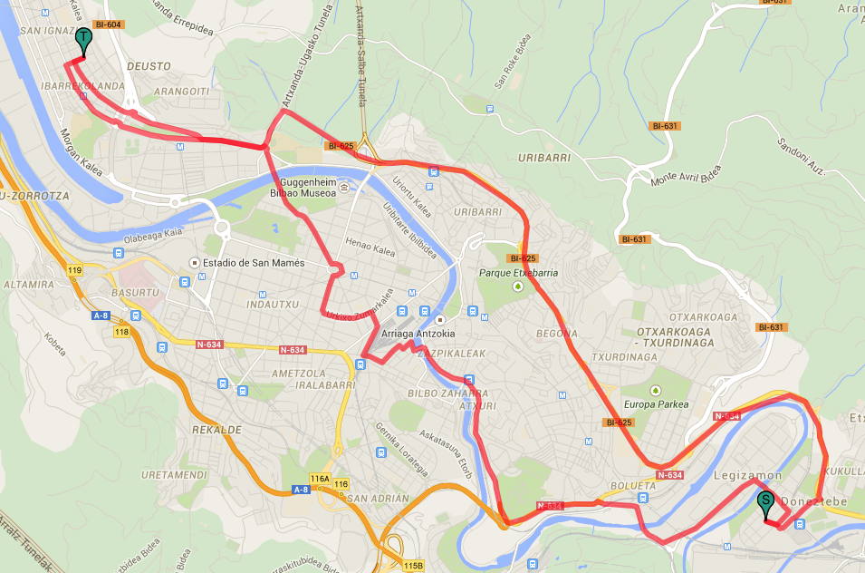
Renewable Mobility Algorithmic Approaches
Highlight – 2
Towards Route Planning Algorithms for Electric Vehicles with Realistic Constraints
Electric Vehicles (EVs):
Future means of transportation
Run on regenerative energy sources
Downsides of EVs:
Restricted battery capacity
Long recharging times
“Range anxiety”
Include recharging duration in computation of fastest routes
Results:
Query times from hours/minutes speed up to at minutes/seconds
Multiple charging stations with different charging speeds supported
Very fast heuristics that compute nearly optimal solutions
Can be extended to compute eco-friendly routes

Slide 16





Renewable Mobility Algorithmic Approaches
Algorithmic development
Incentivized Vehicle-Sharing: Derive route/parking alternatives that effectively incentivize users and maximize the number of satisfied user requests under priority for vehicle relocations
Alternative routes
A → S₁ → S₃ → B (shortest time)
A → S₁ → S₂ → B (incentivized scheme)
Occupancy: 15%
S₂
S₁
B
A
S₃
Occupancy: 80%

Slide 17




Renewable Mobility Algorithmic Approaches
Algorithmic development
Occupancy: 15%
S₂
S₁
B
S₃
A
Occupancy: 80%
Incentivized Vehicle-sharing Sheme(IVS)
Decision Model
IVS incentivizes requests depending on the priorities of S2S vehicle relocations
Users place a value on the additional cost (effort) and/or time to change their original (destination) station
Incentives counterbalance this additional cost
Approach
Computing an optimal set of route suggestions optimizing stations’ occupancies, therefore maximizing the profit of the VSS
Design a pricing policy and a mechanism for deciding the set of route suggestions while ensuring budget feasibility and/or incentive compatibility

Slide 18
Renewable Mobility Algorithmic Approaches
Algorithmic development
Incentivized Vehicle-sharing Scheme(IVS) - explained
Priorities
Capture the difference between developing occupancies (i.e. active reservations) and desired (target) occupancies – target occupancies for each time slot form an ideal distribution for the system to maximize social welfare (profit + satisfied requests) effortlessly. They are best determined by statistical analysis of historical data.
Optimization
weighted 3-set {requests, vehicles, parking spaces} packing problem (weights: relocation priorities)
Maximum weight IS problem on 4-claw free graphs (2-approximability).
IVS Refund Mechanism (2 options)
Uniform Rate refund mechanism Uniform-rate refund for all users based on user costs and relocation priorities One-way truthful Budget –feasible | Simple Proportional refund mechanism Adopted refund proportional to relocation priorities No user costs are taken into account Budget -feasible

Slide 19
Energy-efficient Multimodal Route Planning
Highlight – 1
Transport fuels (EU)
Electricity (ES mix)
Global warming potential (GWP 100a, IPCC 2013)
Global warming potential (GWP 100a, IPCC 2013)
Cumulative energy demand (CED v1.08)

Slide 20




Energy-efficient Multimodal Route Planning
Highlight – 2
Conventional passenger cars
Electric vehicles
Dynamic emission factors from Handbook Emission Factors for Road Transport (HBEFA)
Integrated in a MongoDB:
Inputs:
Traffic situation
Road gradient
Car engine technology
Engine size class
Emission class
Fuel type (for bifuel vehicles)
Outputs:
Emission factors for CO₂, CH₄, N₂O
Fuel consumption
Physics-based vehicle model → Estimation of traction power, i.e. power required to overcome the forces opposing to the movement of the vehicle and drive it at speed u
EV components model → Transformation of traction power requirements (at wheels) into EV battery power requirements
Accessories
Normal forward driving
Regenerative braking
Battery
Motor & controller
Gear system
Wheels
Energy flows in typical battery powered EVs

Slide 21
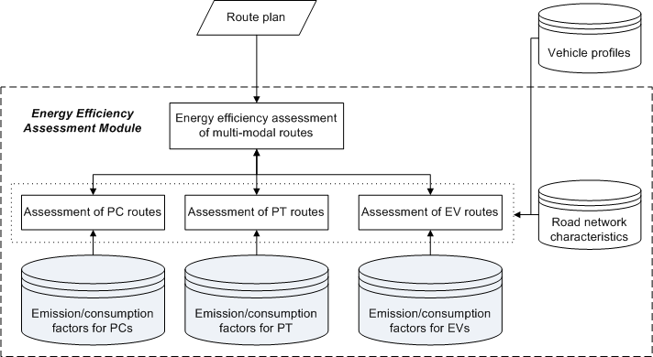
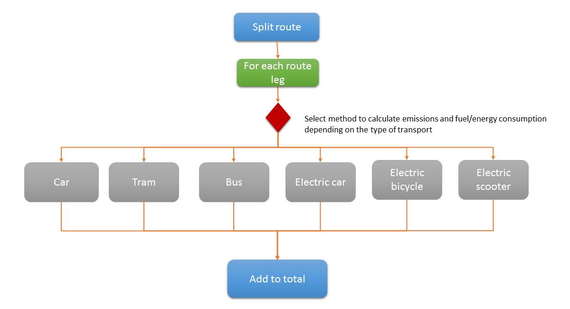
Energy-efficient Multimodal Route Planning
Highlight – 3
Development of Energy Efficiency Assessment Module (EEAM) as web-service:
Purpose: Integration of components for energy efficiency assessment of multimodal routes
Challenge: Low response time
Approach:
Split route into legs by mode of transport
Parallel queries to databases of emission/consumption factors
Parallel processing of route legs

Slide 22
Outlook
This year the main technical developments have been completed - ready for the pilots
We seek collaborations with other project in the area of ITS for exchanging ideas and joining forces
We expect to establish a considerable user base in addition to the pilot users
Innovative business models

Slide 23
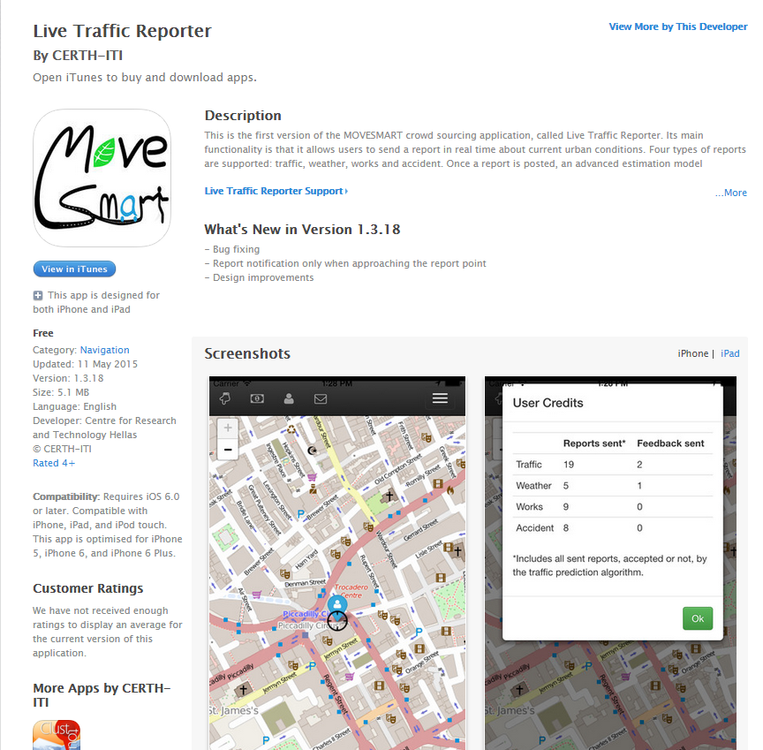
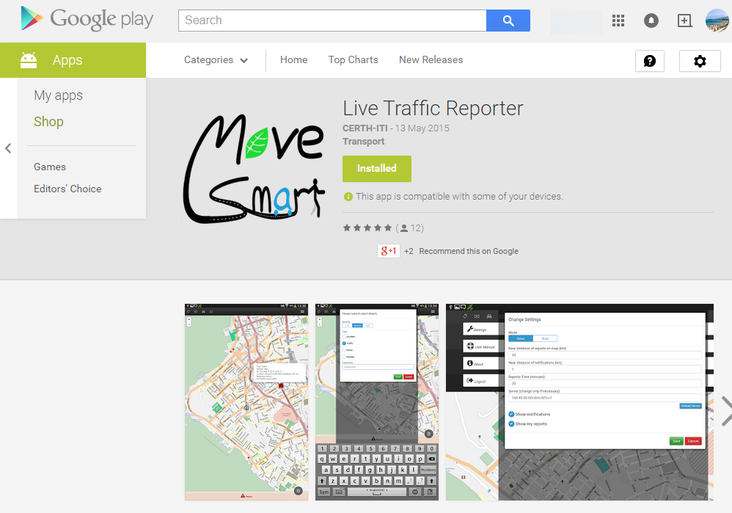


Download MOVESMART
http://www.movesmartfp7.eu/

Slide 24

Q & A

